Slide 1


High Impact Skills Development Program Object Detection Module Project
Presented by:
Tufail Ashraf
Roll no:GIL-DSAI-030

Slide 2
Project Overview
Introduction to YOLOv5: Briefly explain YOLOv5 as a state-of-the-art object detection model.
Project Purpose: Detect specific objects in images using a custom-trained YOLOv5 model.
Key Components: Dataset preparation, model training, evaluation, and real-world application.

Slide 3

Designer helps you get your point across Objectives
Main Goals:
Create and manage a dataset using Roboflow.
Set up YOLOv5 for training and testing.
Evaluate model performance for accuracy and robustness.
Roboflow

Slide 4
Prerequisites
Required Tools:
Python 3.7+, Jupyter Notebook, Git.
YOLOv5 dependencies and Roboflow library for dataset management.
Installation Commands: Overview of package installations.
:
.
.

Slide 5



Setup Process
Step 1: Clone the YOLOv5 repository from GitHub.
Step 2: Install YOLOv5 dependencies and Roboflow.
Step 3: Import essential libraries like torch and os.

Slide 6
Dataset Preparation
Loading Dataset: Use Rooflow to manage and download datasets.
Configuration: Setup with separate folders for train, val, and test, using YOLO format labels.
Data YAML File: Structure for data.yaml with paths and class labels.

Slide 7
Model Training
Training Setup: Run train.py script with specified parameters:
Image Size: 640 pixels
Epochs: 120
Weights: Using pretrained yolov5s.pt
Training Example Code: !python train.py --img 640 --epochs 120 --data {dataset.location}/data.yaml --weights yolov5s.pt
.

Slide 8

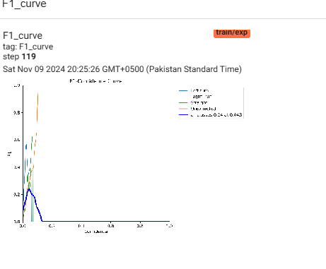
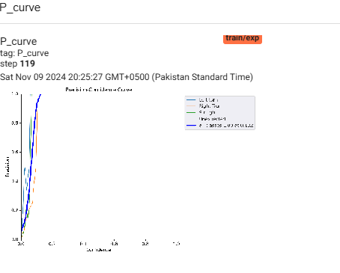
Evaluation and Inference
Evaluation Metrics: Confusion matrix, precision, recall, F1 score, mAP.
Inference Example:

Slide 9
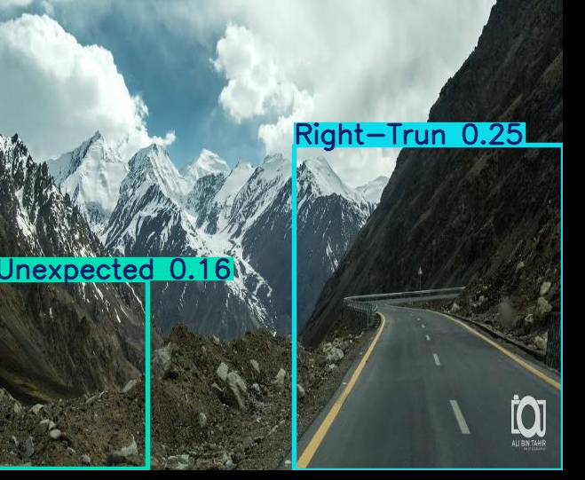
Results and Metrics
Performance Metrics: Visuals or charts of model performance on the validation dataset.
mAP and Other Metrics: Highlight the model’s detection accuracy.

